Slide 1

Welcome

Slide 2

Blockchain Technology
Building Blocks for a Better World!!!!!!!

Slide 3
What is Blockchain ?
Blockchain is a decentralized digital ledger technology that enables secure and transparent record-keeping of transactions across a network of computers.
Here's how it works:
Decentralization: Unlike traditional centralized systems where a single authority controls the data, blockchain operates on a decentralized network of computers (nodes). Each node has a copy of the entire blockchain database.
Blocks: Transactions are grouped together into blocks. Each block contains a timestamp, a cryptographic hash of the previous block, and the transaction data.

Slide 4




Block Chain
Data Base

Slide 5
About Blockchain
Blockchain is a distributed ledger technology that enables secure, transparent, and decentralized record-keeping of transactions. Here are some key points about blockchain:
Decentralization: Blockchain operates on a decentralized network of computers (nodes). Each node stores a copy of the entire blockchain database, eliminating the need for a central authority.
Blocks: Transactions are grouped together into blocks. Each block contains a timestamp, a reference to the previous block (via a cryptographic hash), and the transaction data.
Cryptographic Hashing: The cryptographic hash of each block includes the data in the block and the hash of the previous block. This creates a chain of blocks, where any alteration to a block would require changing subsequent blocks, making the blockchain resistant to tampering.
Consensus Mechanisms: Before a new block can be added to the blockchain, the majority of nodes in the network must agree that the block is valid. Various consensus mechanisms, such as Proof of Work (PoW) and Proof of Stake (PoS), ensure that the network remains secure and that all copies of the blockchain are synchronized.
Immutability: Once a block is added to the blockc

Slide 6
What is Data visualation ?
Data visualization is the graphical representation of data and information. It involves the creation of visual elements such as charts, graphs, maps, and dashboards to communicate insights and patterns hidden within data. The primary goal of data visualization is to make complex datasets more accessible, understandable, and interpretable to users.
Here are some key aspects of data visualization:
Representation: Data visualization transforms raw data into visual elements that are easier for humans to comprehend and analyze. Different types of visualizations, such as bar charts, line graphs, pie charts, heatmaps, and scatter plots, are used based on the nature of the data and the insights to be conveyed.
Insight Discovery: By presenting data visually, patterns, trends, correlations, and outliers become more apparent. Data visualization enables users to gain insights into the underlying data quickly, leading to better decision-making and problem-solving.
Storytelling: Effective data visualization can tell a story by guiding users through the data, highlighting key findings, and supporting conclusions with visual evidence. Visualizations can be combined into narratives or presentations to convey complex information in a compelling and engaging way.

Slide 7
Retation With Data Entry
Data Collection: Data entry is often the initial step in the data lifecycle, where raw data is captured and recorded into a digital format. This data can then be processed and analyzed. Once the data is entered, data visualization can be used to interpret and explore the dataset visually.
Quality Assurance: Accurate data entry is crucial for ensuring the quality and integrity of the dataset. Data entry processes may include validation checks and verification steps to minimize errors. Data visualization can be used to identify anomalies or inconsistencies in the data that may require further investigation.
Exploratory Analysis: After data entry, data visualization techniques can be applied to explore the dataset and identify patterns, trends, and relationships. Visualizations such as scatter plots, histograms, and heatmaps can help uncover insights and guide further analysis.

Slide 8
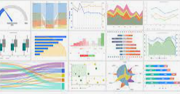
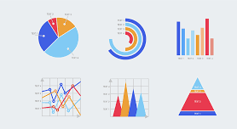
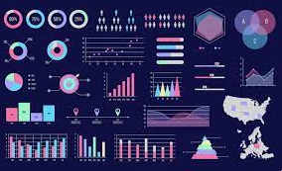
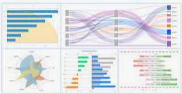
Data visualation

Slide 9
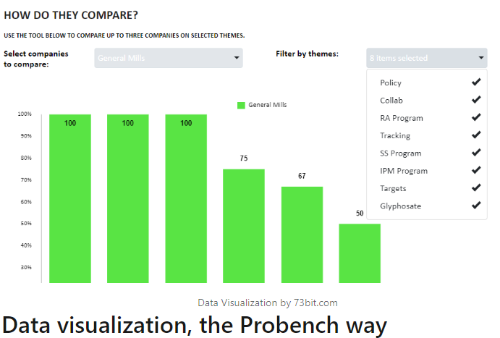
HOW DO THEY COMPARE?

Slide 10
Thank You

